Slide 1
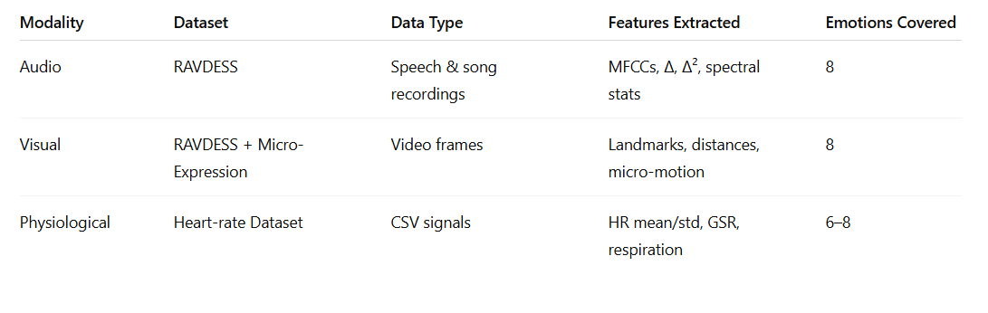
DATASETS USED
RAVDESS – Ryerson Audio-Visual Database of Emotional Speech
Facial Micro-Expression Dataset: CAS(ME)²
Physiological Emotion Dataset (Heart-Rate Based)

Slide 2
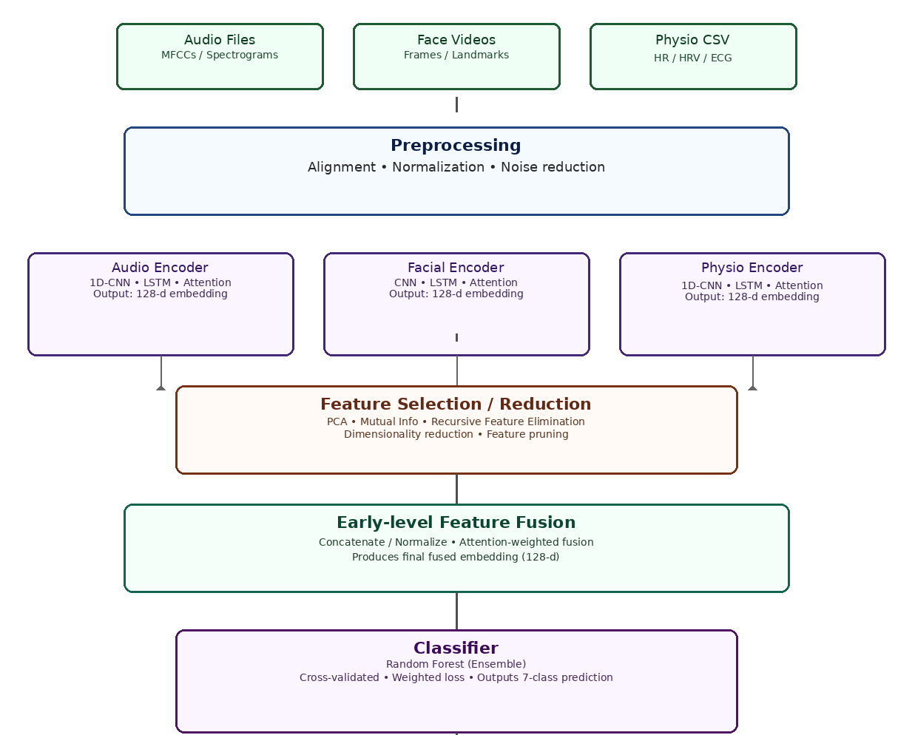
IMPLEMENTED METHODOLOGY (System Architecture)

Slide 3
RESULTS
Model / Modality | Accuracy | Weighted F1-Score | Remarks
Audio (MFCC features) | 63.4 % | 0.61 | Captures tone & pitch variations
Facial (CAS(ME)² features) | 68.2 % | 0.66 | Strong for visible emotions
Physiological (Heart-rate CSV) | 55.7 % | 0.54 | Limited signal diversity
Multimodal Fusion | 79.3 % | 0.78 | Best performance after feature engineering

Slide 4
Limitations
Limited Real-Time Performance:
The current FastAPI + ngrok deployment processes doesn’t work in my Colab environment.
Physiological Signal Quality:
Heart-rate data collected from different sensors show inconsistency, limiting generalization.
Dataset Imbalance:
Some emotions (e.g., disgust, fear) have fewer samples in RAVDESS and CAS(ME)², slightly biasing predictions.

Slide 5
Future Scope
Real-Time Multimodal Streaming:
Integrate continuous webcam + microphone input with on-device inference (using TensorFlow Lite or PyTorch Mobile).
Deep Learning Fusion:
Replace Random Forest with a hybrid deep model (CNN–LSTM or Transformer) for temporal sequence modeling and attention-based fusion.
Dynamic Weight Fusion:
Implement attention mechanisms or late fusion (decision-level) to weight modalities based on confidence or signal quality.
Expand Physiological Modalities:
Include additional biosignals like GSR, EEG, or respiration for richer affective state estimation.

